Slide 1
U know where lmao

Slide 2
Design Systems
Week 6

Slide 3
Announcements
Group project check-in is due TONIGHT
Items required for check-in here
You may check-in right after end of lecture today
Homework 6 will be uploaded later tonight and due next Monday.
Notes:
Checkin:
need at least 2 members
expect high fidelity wireframes for each of the views
also have website structure populated and html skeletons done for at least 2 views (rough outline, don’t need classes or ids yet)

Slide 4
What We Know So Far
Design Process (HCD)
Spacing
Colors
Images
Basic Prototyping
Today: putting it all together…

Slide 5
Today’s Agenda
What is a design system?
Why is it important?
How do I create a design system?
Practical applications in development
Existential Questions (that you don’t really have to worry about)

Slide 6
What is a design system?

Slide 7
First — Style Guide (Distinction)
Style guides focus mainly on, you guessed it, style.
They include colors, fonts, logos, and brand attributes.
Heavily utilized by design and marketing teams because style guides contain the brand which is the first communicated.
Design system is more than just visual presentation; it focuses on the ecosystem.
Notes:
A style guide is not the same as a design system!

Slide 8
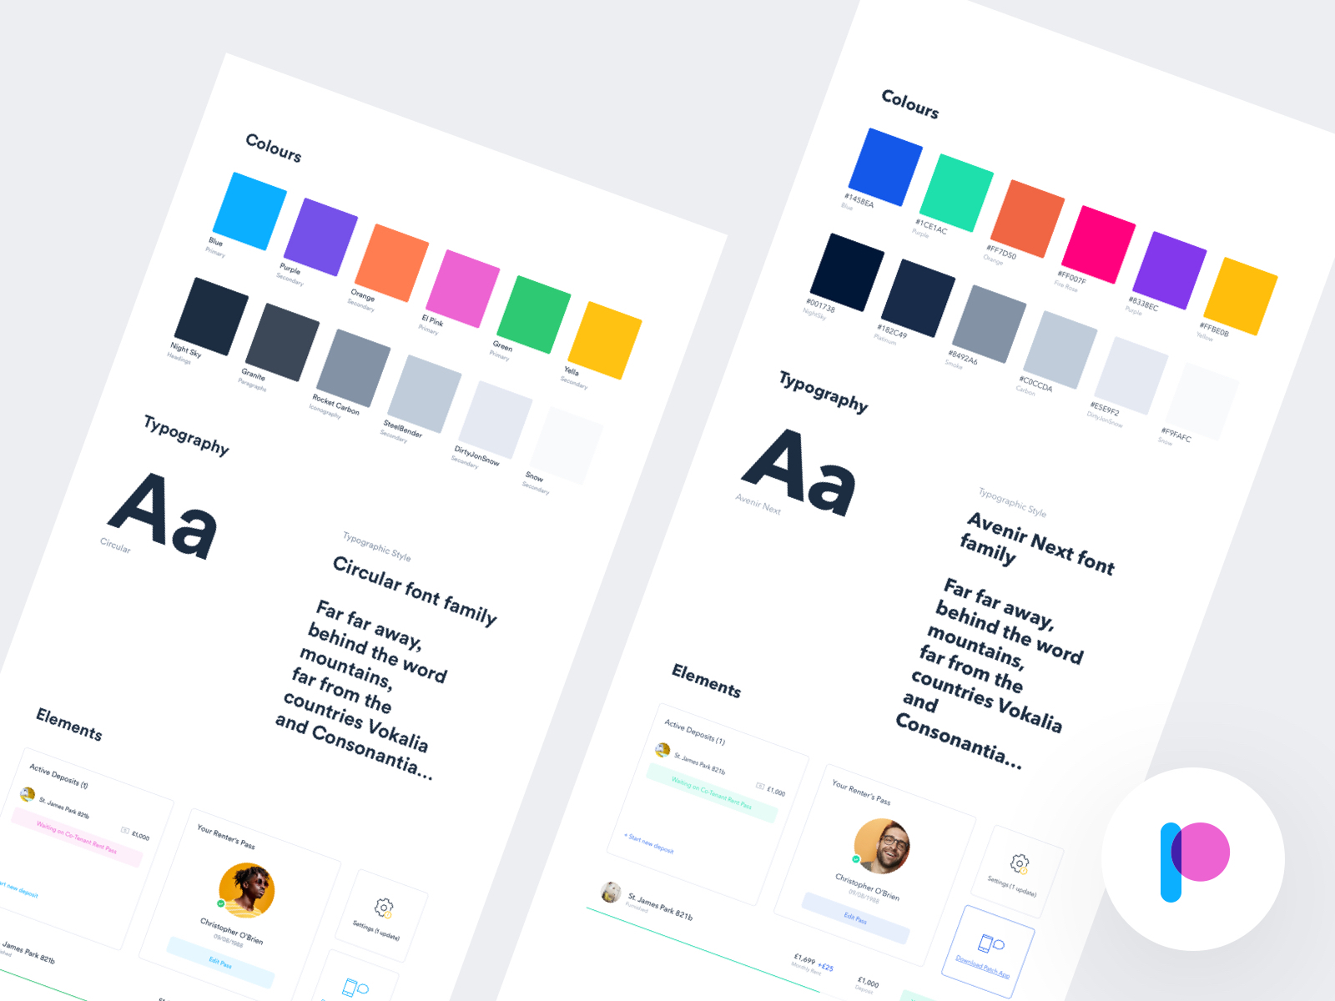
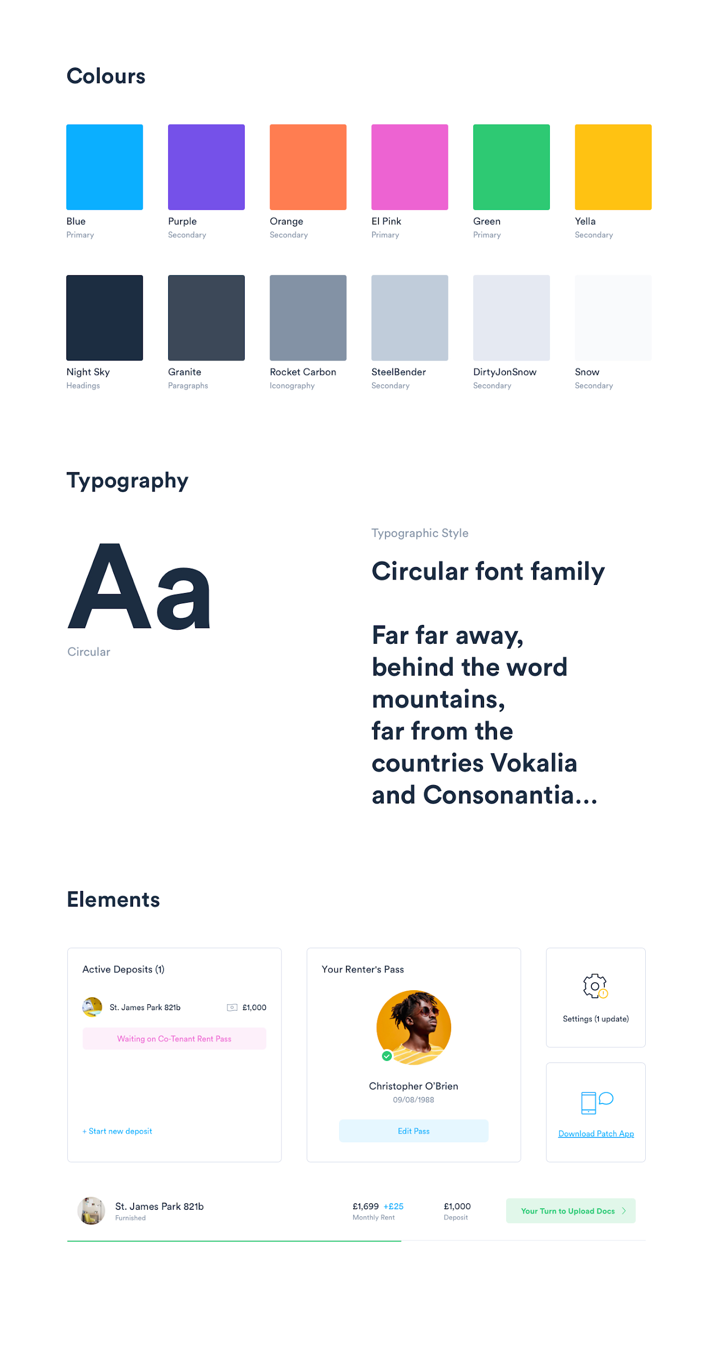
Style Guide — Focuses on very basics of brand

Slide 9
Design System Definition
A set of shared, integrated patterns and principles that define the overall design of the product.
Almost always, a design system offers a library of visual style and components documented and released as reusable code for developers and/or tool(s) for designers. A system may also offer guidance on accessibility, page layout, and editorial and less often branding, data viz, UX patterns, and other tools.
Notes:
A style guide is not the same as a design system!

Slide 10
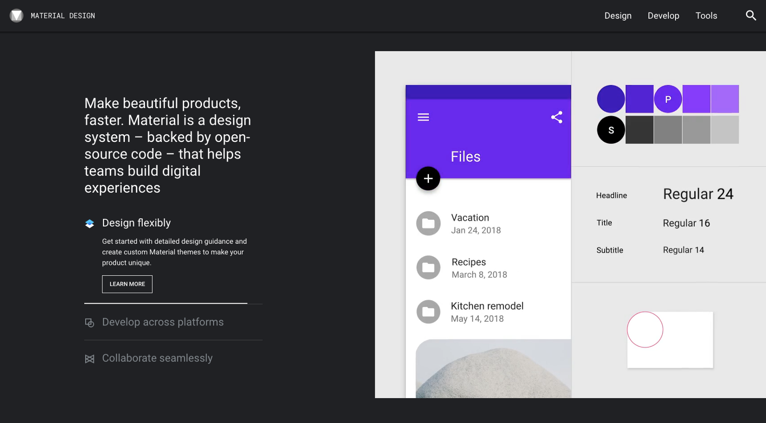
Design System (Google, Material Design)

Slide 11
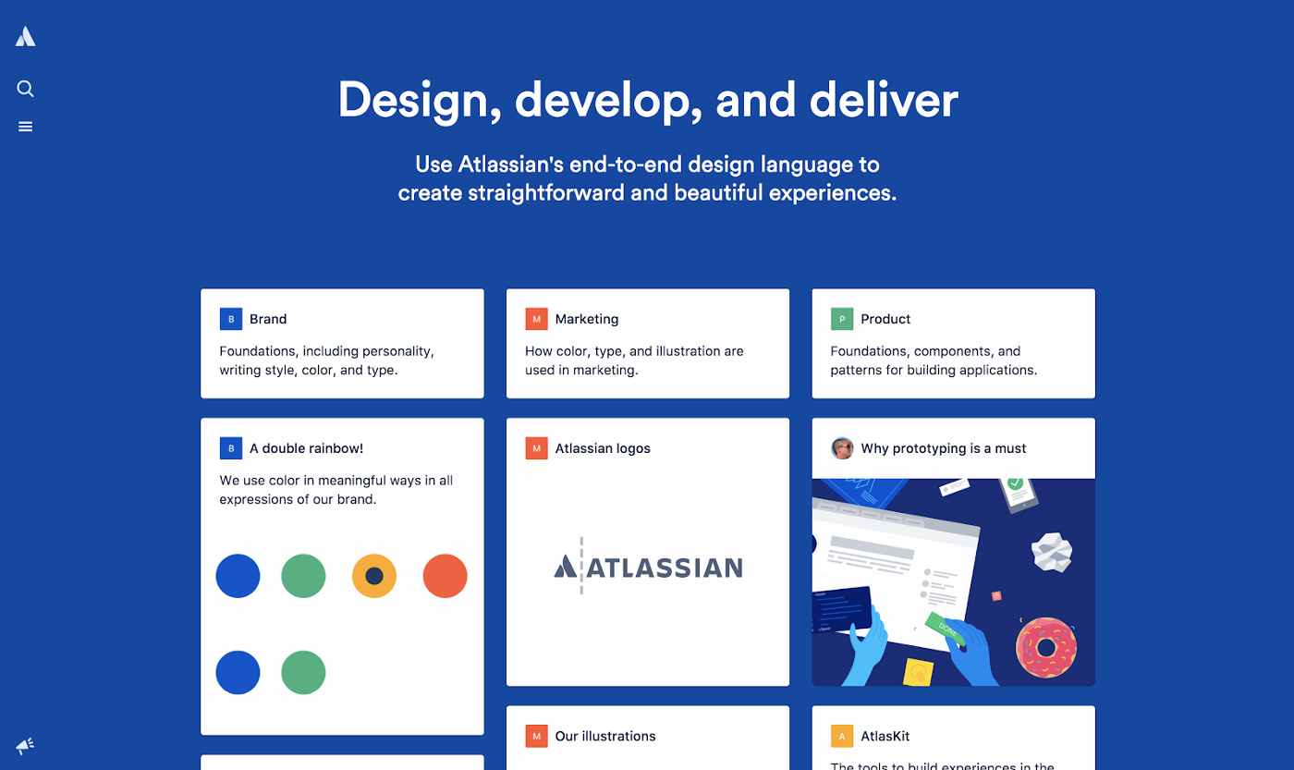
Design System (Atlassian)

Slide 12
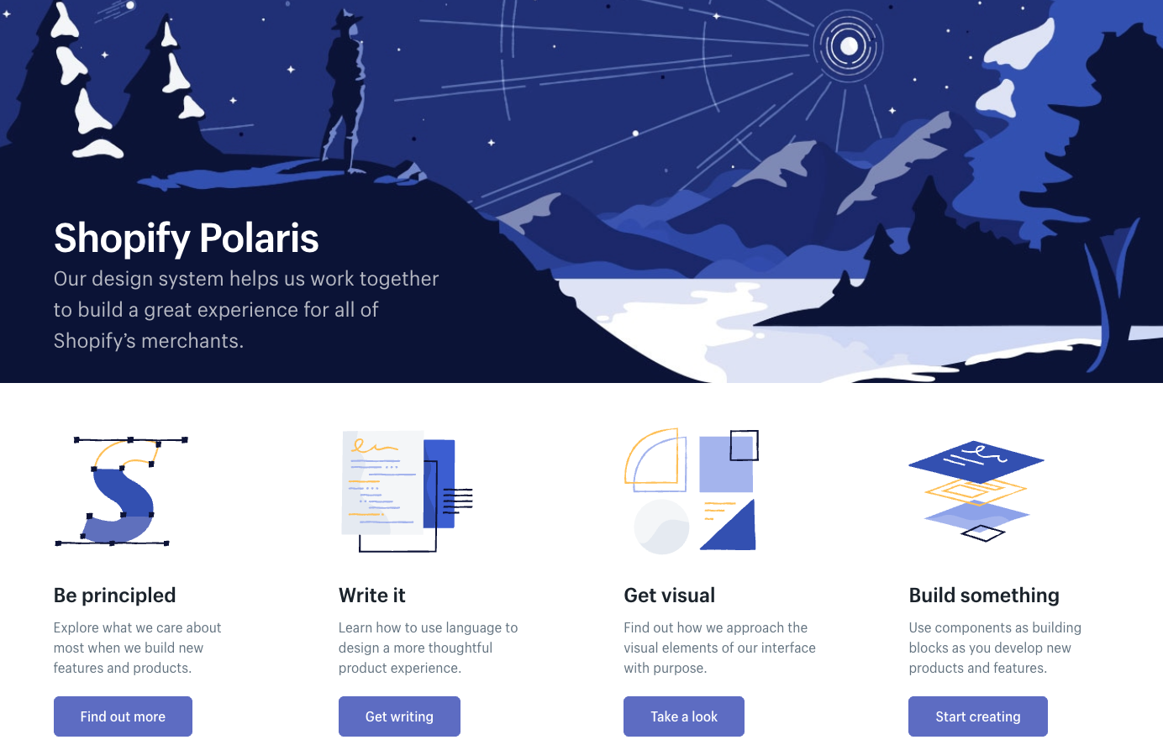
Design System (Shopify, Polaris)

Slide 13
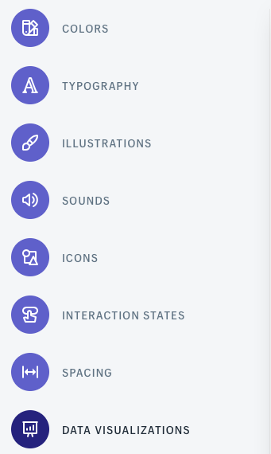
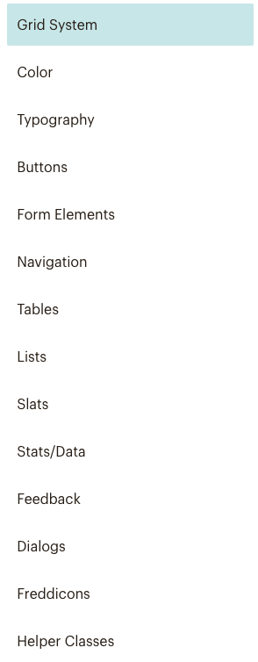
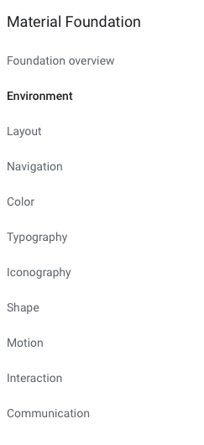
Parts of a Design System
Philosophy/Goals
Layout/Grid (Spacing)
Color
Typography
Iconography
Motion
Interaction
Language (Voice & Tone)
Illustration

Slide 14
Why do we even need a design system?

Slide 15
Why are design systems important?
Design systems bring order to chaos. Everyone is kept on the same page, so the entire product remains consistent and polished throughout.
Design systems improve the user experience through the repeated use of familiar and proven patterns. Designing anything from scratch leaves room for error, so try to use what already works.
Design systems improve workflow efficiency. Product teams know exactly how components of new features should look and how to implement them.

Slide 16
Why do we even need a design system?

Slide 17
Business Perspective
As a company begins to grow, it’s important to use resource (both time of designers and developers) to be used efficiently. Some questions companies might ask are:
How will we design consistent UIs across platforms when many teams own various parts of our products?
How will we empower all of these teams to iterate quickly?
How will we maintain the inevitable design debt that will build up as many designers create new and tailor-made designs?

Slide 18
Business Perspective
Defining and adhering to standards is how we create that understanding. Doing so removes the subjectivity and ambiguity that often creates friction and confusion within product teams.
Standards encompass both design and development. Standardizing things like naming conventions, accessibility requirements, and file structure will help teams work consistently and prevent errors.
Many, many platforms. Software should scale across multiple devices and platforms, in a time in which people are using all different types of devices.

Slide 19
Implementing a Design System

Slide 20
How do I make a Design System?
Defining and adhering to standards is how we create that understanding. Doing so removes the subjectivity and ambiguity that often creates friction and confusion within product teams.
Standards encompass both design and development. Standardizing things like naming conventions, accessibility requirements, and file structure will help teams work consistently and prevent errors.

Slide 21
Things to Keep in Mind
Accessibility— WCAG Standards
Lyft’s colobox.io
Diversity and Inclusion
https://ux.shopify.com/you-cant-just-draw-purple-people-and-call-it-diversity-e2aa30f0c0e8

Slide 22
Applying this IRL

Slide 23
Writing Clean Code
Write modular code
Airbnb Example (Github)

Slide 24
Quick Glance at CSS Variables
Illustration
Color

Slide 25
Some Existential Questions

Slide 26
Convergence of Design
Is all design starting to “look the same?”
https://uxdesign.cc/ever-wonder-why-the-most-popular-apps-are-starting-to-look-the-same-it-might-be-a-good-thing-e54aadd50fd5
https://medium.com/s/story/on-the-visual-weariness-of-the-web-8af1c969ce73

Slide 27
Pros + Cons
Pros
Cons
More consistency = better usability “reduce the likelihood of upsetting your users” (Snapchat)
More focus on functionality creativity in other ways
Reduce app fatigue
Might be considered boring/lazy/uncreative/
Cookie-cutter templates
Things literally start to look the same

Slide 28
Famous Case Study: Dropbox Redesign
Seen as a response to converging designs
Called a “fantastic mid-life crisis)

Slide 29
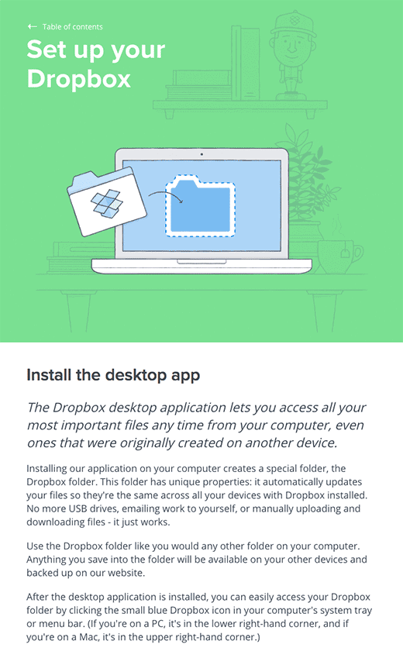
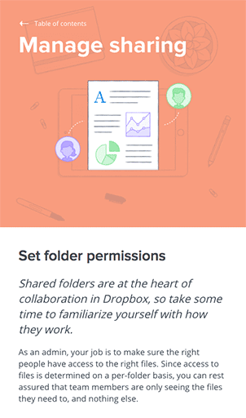

Dropbox: Before

Slide 30
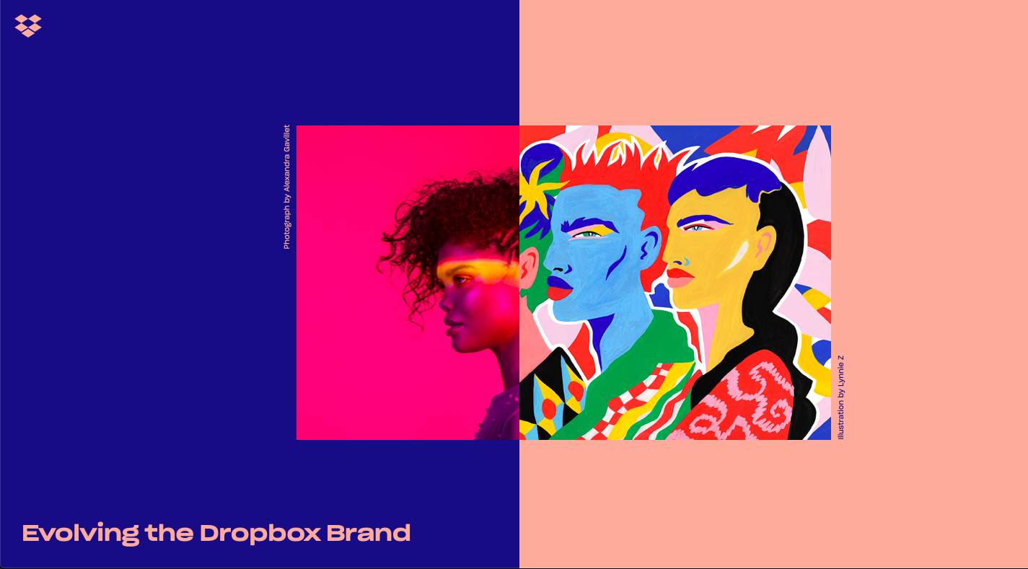
Dropbox: After

Slide 31
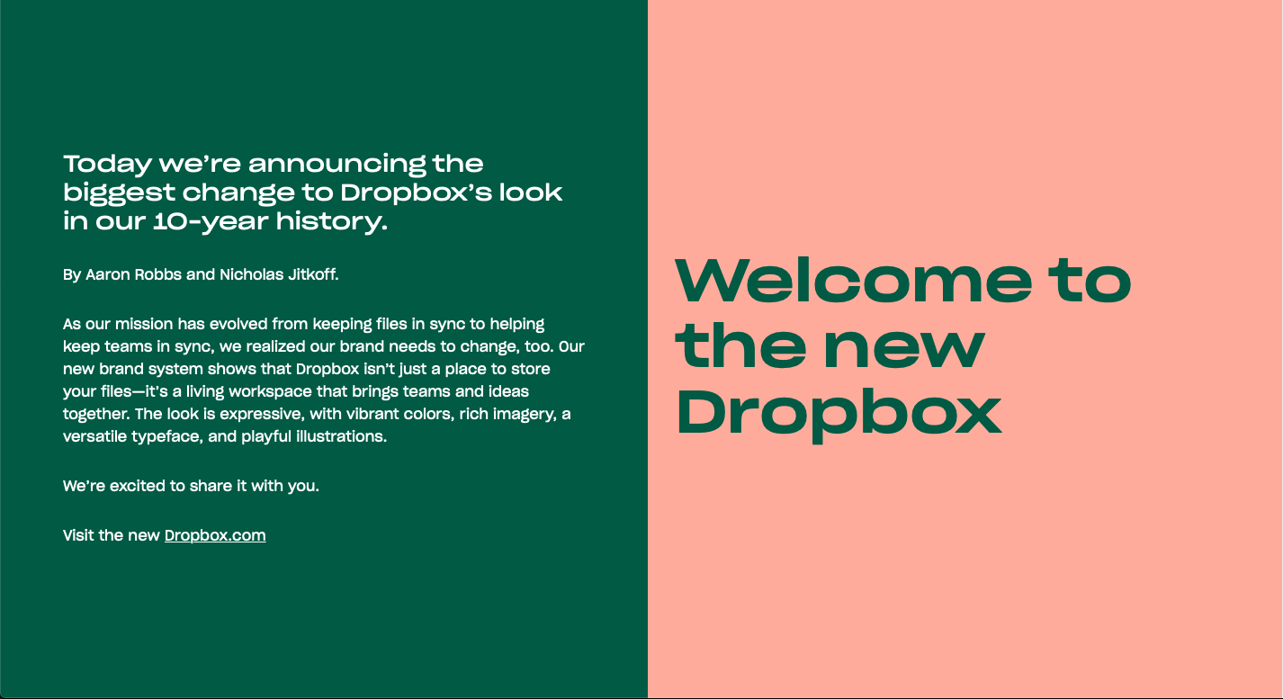
Dropbox: After

Slide 32
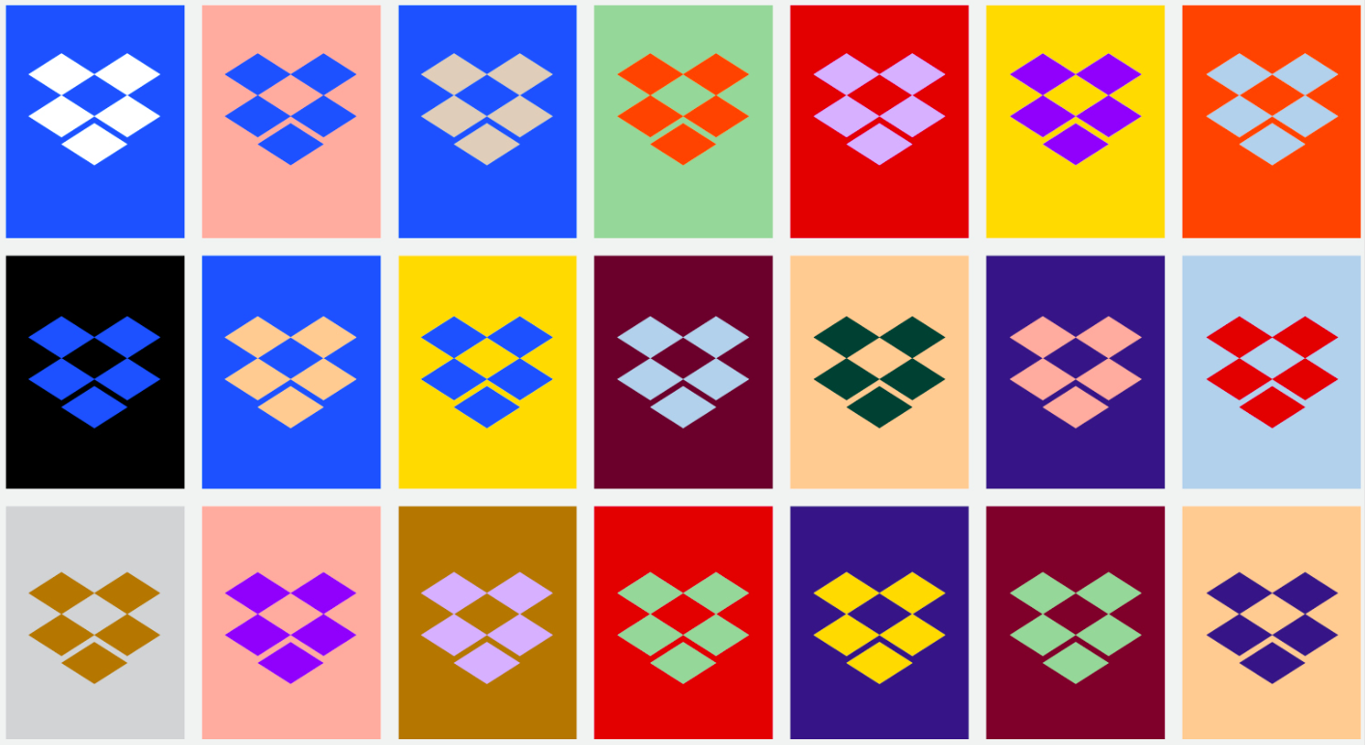
Dropbox: After

Slide 33
Dropbox: After

Slide 34
Summary
The friction between design and development (IRL and in this class, too) can be solved through creating consistent standards, rules, and guides through design systems
There is a huge tradeoff to design systems when thinking in terms of businesses at scale
In the very least, try to define a brand guideline (style guide) for your websites before starting to code to increase efficiency, reduce confusion or friction among your teams, and to make your websites as consistent as possible!

Slide 35
Resources
https://uxdesign.cc/everything-you-need-to-know-about-design-systems-54b109851969
https://medium.com/tradecraft-traction/eight-things-you-need-to-know-about-design-systems-bae8bd884b3b
https://www.designerlynx.co/design-systems
https://www.invisionapp.com/inside-design/guide-to-design-systems/

